Slide 1
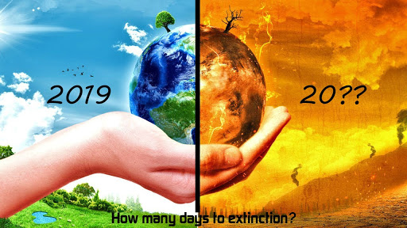

Slide 2
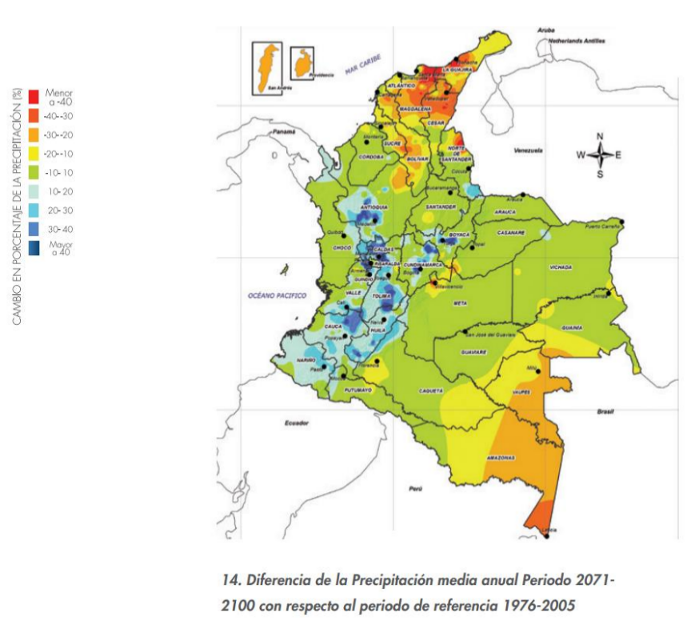
Impact of climate change
Climate change forces migration in Latin America, as this is one of the regions more vulnerable to natural disasters and climate change:
Drought, floods have left more than 20 millon people displaced
According UN climate change is more lethal than Covid
*Variations in rain volume in Colombia in 1976-2005

Slide 3

Carbon Footprint
So, how can we help to reduce it?
The energy we spend in our homes impact the advance of the climate change
We can contribute by knowing how we use the energy, and optimizing their usage
But, how do we know it? The electric bill gives us only the total usage at the end of the month

Slide 4
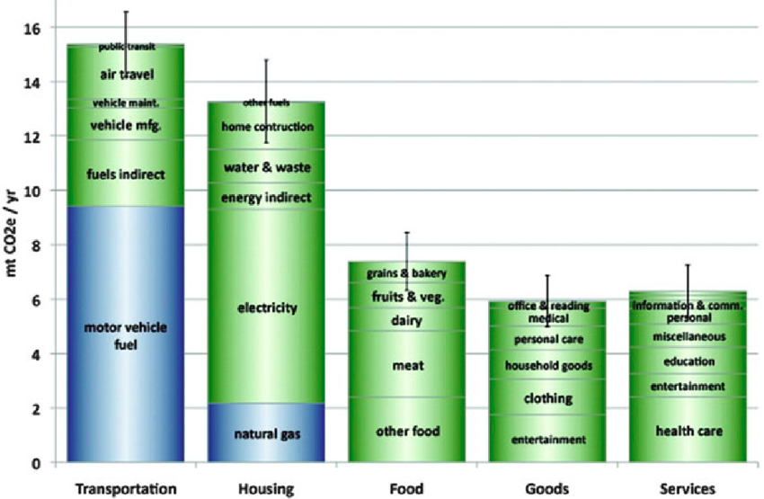

Slide 5
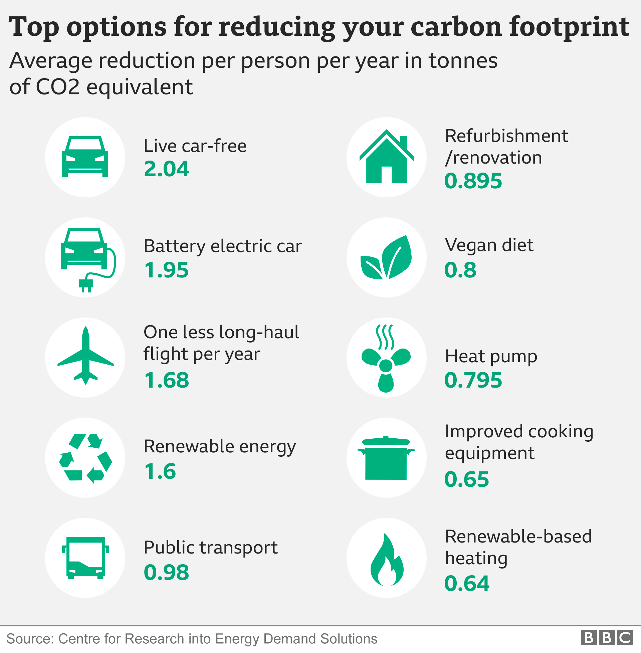
What’s in our hands?
We can help reducing transportation and replacing by more ecologic options, but that is not an option for everyone as most of people uses public transportation
So the next option is to do more efficient usage of renewable energy

Slide 6
Factors affecting measurement of CF
The impact for same amount of energy is different if it comes from coal plant, nuclear, hydraulic or clean energy like solar or wind power
Also water cost is not the same for everyone (water well, rivers, reservoir)
If we are going to measure our contribution to reduce carbon footprint it should be an automatic process with minimal human intervention, getting info from adequate sources of info and correlating it to the measurement data

Slide 7
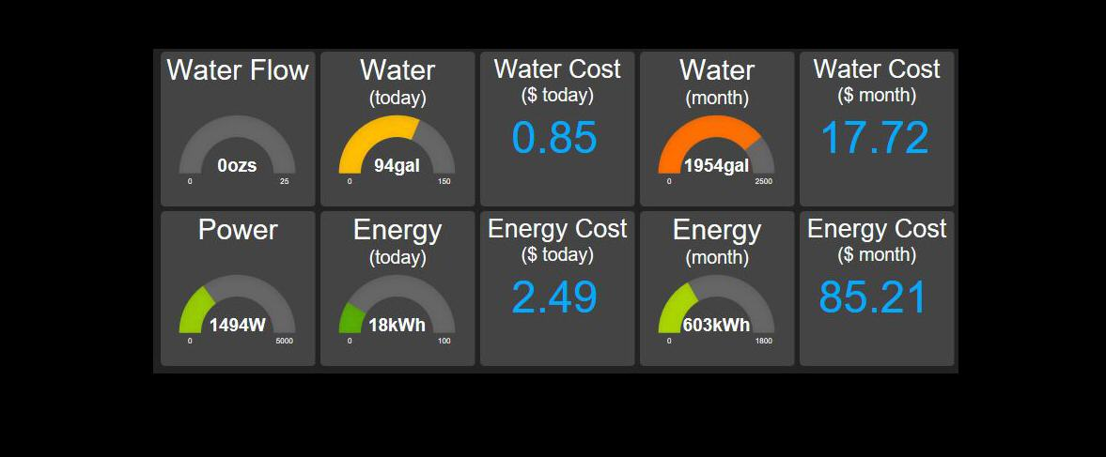
Our project
So, what if we could measure our consumption at home and at work (water, gas, electricity) in a cost effective and collect these measures in a reliable way, and in a longer way to get recognized by our efforts?
h

Slide 8
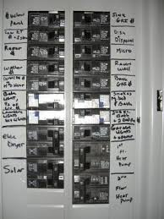
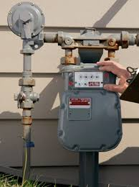
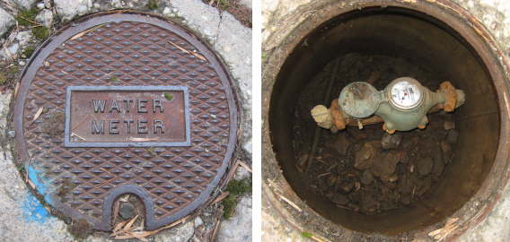
Hometer
All houses, even the poorest, have circuit breaker and several circuits to control devices at home:
One for freezer and kitchen
Other for illumination
Other for cooling or heating
Usually secondary circuits behalf main breakers
So we can plug the circuit in a single point and also control the usage of it.
The same applies for gas or water

Slide 9
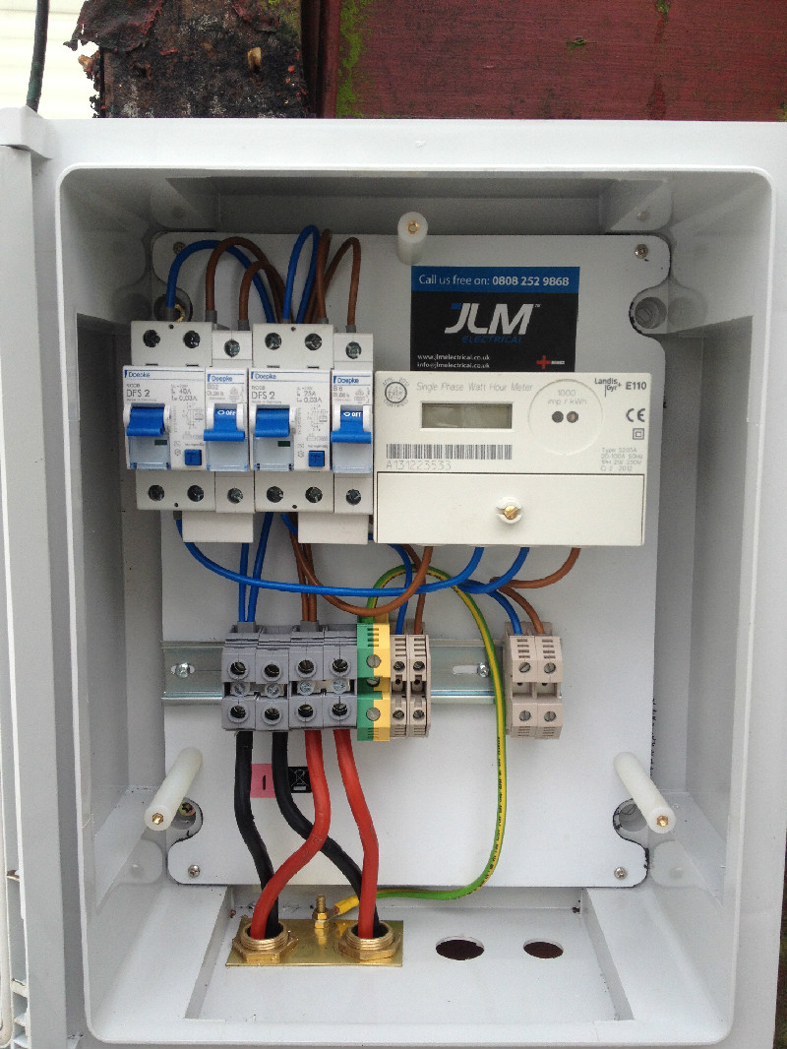
Description
Our project considered the use of non invasive sensors to measure current and water lr gas flow to determine the hourly consumption and be able to measure also reduction in consumption in order to produce a carbon footprint bonus
The placement is on the main electrical panel and uses 1 or two sensors (depending on the phases of the current)

Slide 10
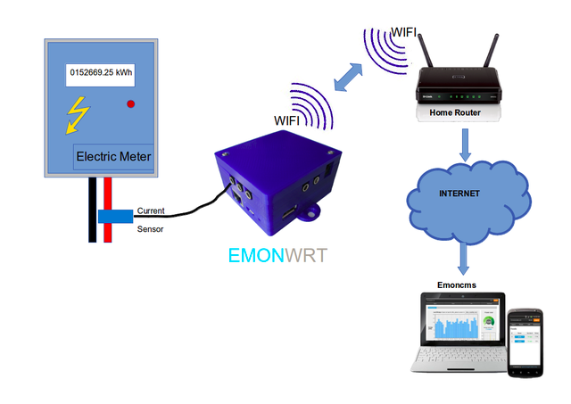
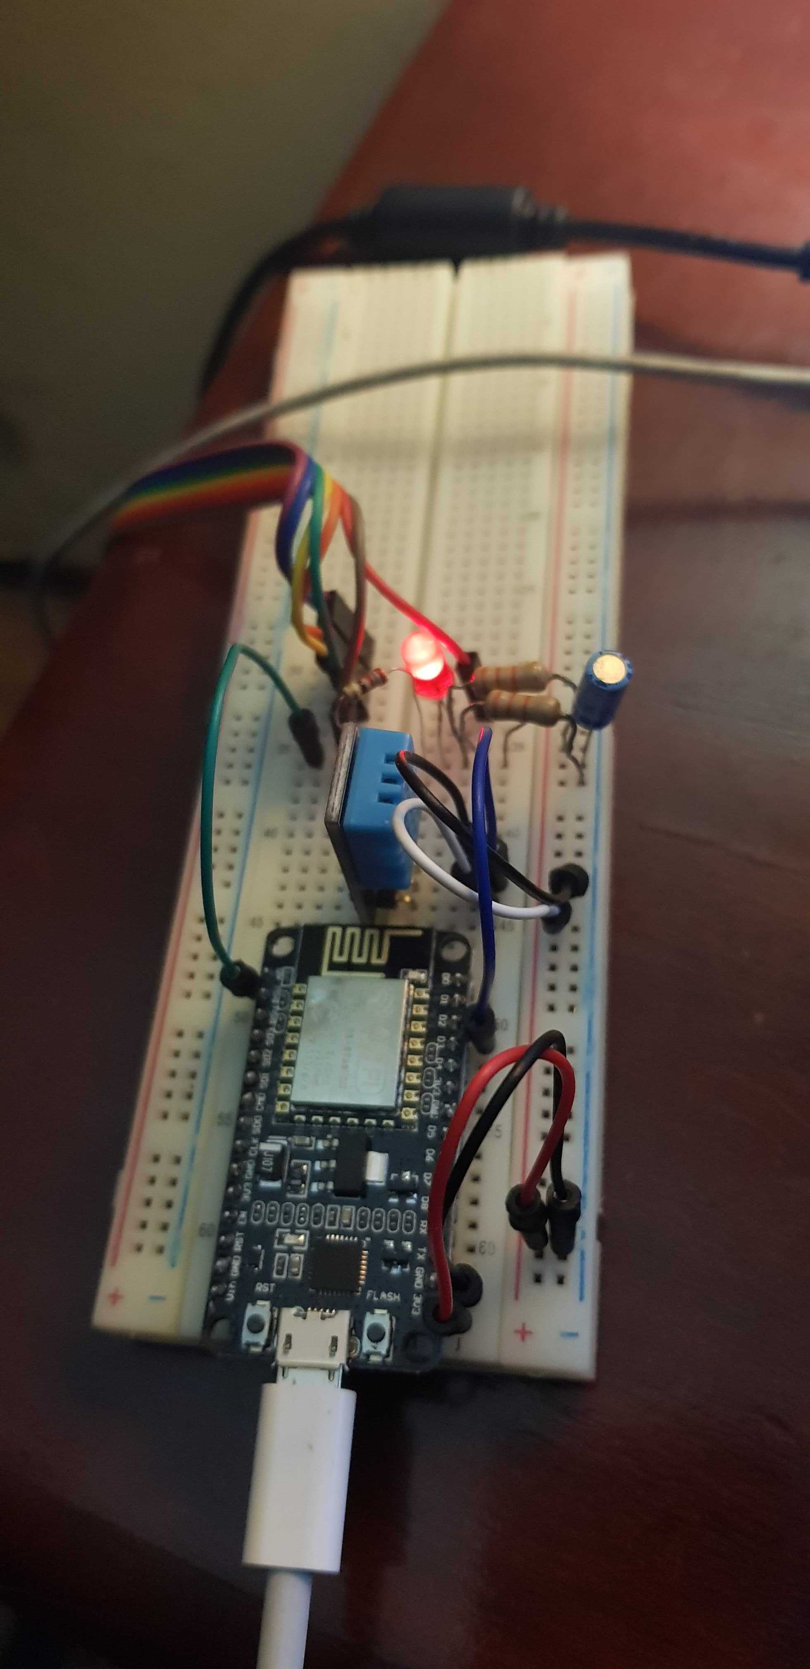
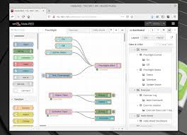
Connectivity
The measured data is sent thru home router (or mobile phone tethering) to Watson IoT and then to node-red app in where the consumption can be retrieved including historical data

Slide 11
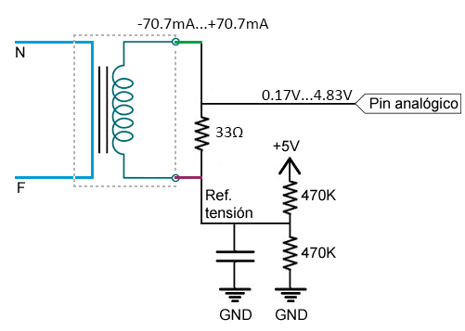
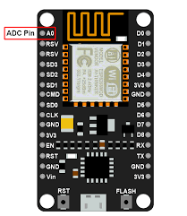
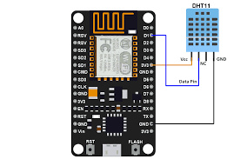
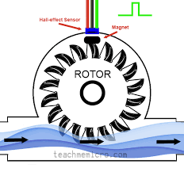
IoT Device design
Single design and single chip design for minimal costs
Energy sensor SCT-013-000
WiFi microcontroller: nodemcu ESP8266
Temperature and humidity sensor DHT11
Optional G3/4 flow sensor to attach to water or gas pipes
Single power line

Slide 12
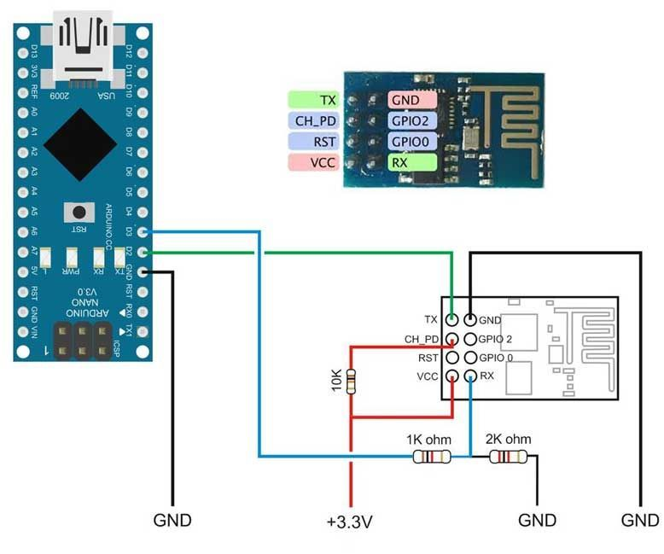
Other device designs
Multiple analog lines, for example for bifasic and trifasic lines, need to switch nodemcu board by arduino nano plus ESP01

Slide 13
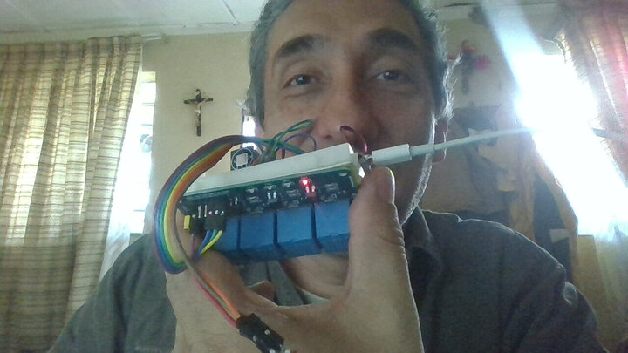
So here is me with the device used
In the device
used we
considered also
relays (in the
concept we
used low power)
but tested with
solid state relays
So the Hometer
also can control
expense in a
daily or weekly
by switching off
circuits once it
reachs its quota

Slide 14
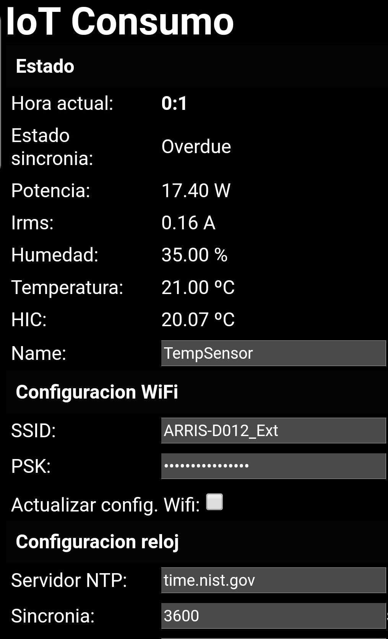
Registration of the device
In order to register the device (both in Watson IoT and in BlockChain) first we need to configure WiFi
First the device creates a hotspot on a private network. The cell phone the connects to this WiFi to 192.168.4.1
Then the user registers the SSID for wi-fi. Can be used mobile phone tethering to connect to internet
The ID for device is a combination of device mac-address and the Name (owner ID)
The variables measured depends on sensors adapted to device (in the example power, temperature and humidity)

Slide 15
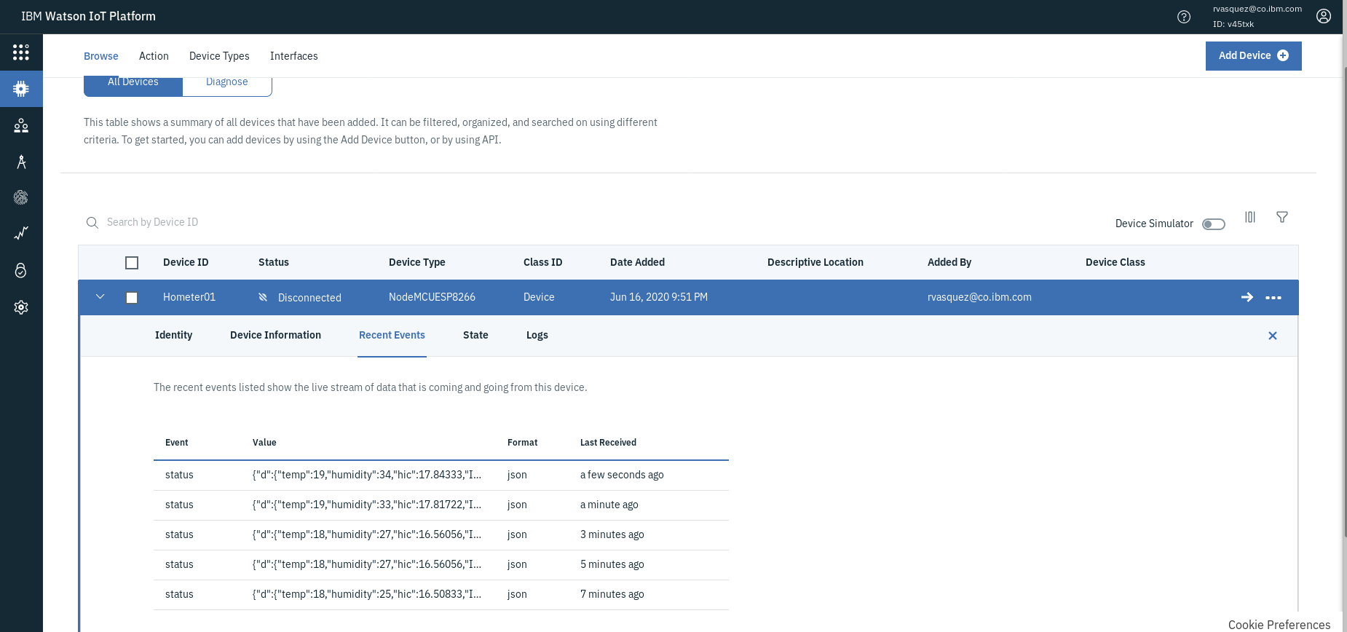
Registration on Watson IoT for multiple devices

Slide 16
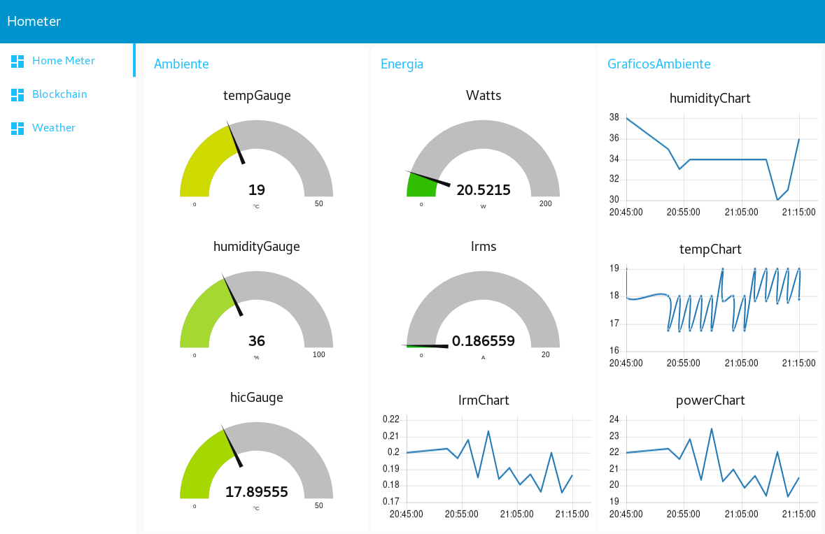
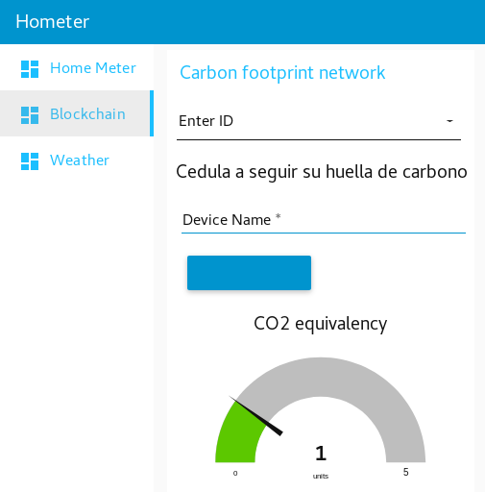
The personal meter

Slide 17
Next steps
Develop additional
capabilities for
Hometer IoT device
Energy remote control
Device mesh network
Develop additional
capabilities for
Cloud app
Historical decrease of
consumption
Energy efficiency in
correlation with hourly
power and water costs
Integrate CO2
equivalencies to
the carbon footprint
network
Sources from energy
companies and operation
scheduling (operation
of coal and natural gas
power plants)
Real consumption for
home appliances
Funding for financial
compensation of
CO2 contribution
Sources from energy
companies and operation
scheduling (operation
of coal and natural gas
power plants)
Real consumption for
home appliances

